Slide 1

DIET PLANNER
GROUP MEMBERS
1.ANERI SHAH
2.MINAKSHI GOYAL
3.RISHI RAJ GUPTA
4.SRIJA GANGUALY

Slide 2
OVERVIEW
BMI Calculator is a simple application for your entire daily health and fitness requirements (calorie and nutrition).
The fastest and the easiest way to use calorie and nutrition intake calculator for android.
Considering the fact that we have now almost 1.25 billion people in our country and 900 million mobile subscriptions out of which 500 million people own a smartphone running some mobile OS like Android or IOS.
This app is designed to target every smartphone user who wish to monitor his or her health the easy way.

Slide 3
FEATURES & BENEFITS
Calculates BMI
BMR Calculator = Basal Metalbolic Rate
TDEE Calculator = (Total Calories intake calculator ) How many calories should you be consuming each day?
All calculations are based on the specifications of an individual (height,weight,age,gender)
Customized diet plans for individuals.

Slide 4
HOW OUR APP IS DIFFERENT FROM OTHER APPS AVAILABLE IN THE MARKET
Today there are almost 1.3 million applications available in the google play store
So what makes our application different ?
Elegant and simple user interface
So many features like (BMI,BMR,Water intake,etc ) all included in just one app.
Future advancements(tracking health progress of an individual )
Customizable diet plans to match the needs of an individual.

Slide 5
APPLICATIONS
The App can target all age groups of people because of its simplified interface.
Body Mass Index( BMI Calculator ): is defined as the body weight divided by the square of the height. BMI Calculator provides a rough guide since it doesn't take into account a persons build or the composition of the body weight. Just enter your weight and height and get the BMI value and also your ideal weight range. -BMI Calculator can be used to find your healthy weight if you want to lose weight or are on diet.

Slide 6
APPLICATIONS
TDEE is the amount calories your body burns in a 24 hour period, sleeping, working, exercising, playing and even digesting food! The IIFYM TDEE Calculator is designed to give you your exact TDEE based on a few key factors (BMR + TOTAL ENERGY EXPENDITURE).
BMR = Basal Metalbolic Rate (similar to RMR = Resting Metabolic Rate) Your BMR (BMR calcualtor) is represents the number of calories your body burns at rest. The BMR calcualtor will calculate the precise amount of calories your individual body requires to keep you alive.

Slide 7
SPECIFICATIONS
The various android tools and techniqus used for the development of the applicaton are as follows :
Intent
Toasts
Buttons to go to next page
Buttons to choose type of meal

Slide 8
FUTURE ADVANCEMENTS(STILL UNDER PROGRESS)
Include a database to constantly update the diet plan of an individual while keeping in the mind the various factors like the BMI,BMR and other measurements.
Create a database to collect data over a months time and display the progress (if any).
Water intake calculator.
Customisable diet plans
Macros Nutrients Calculator - How many grams of Carbohydrate, Protein, and Fat should you be eating at each meal?

Slide 9
DATABASE
This application also provides the facility that helps in storing the details of the user.
The user can see his previous records i.e. Height, Weight and BMI.
Also, he can keep a track to check whether he is improving or not.
Database also shows a scrap figure that intends to be his/her future BMI score.

Slide 10
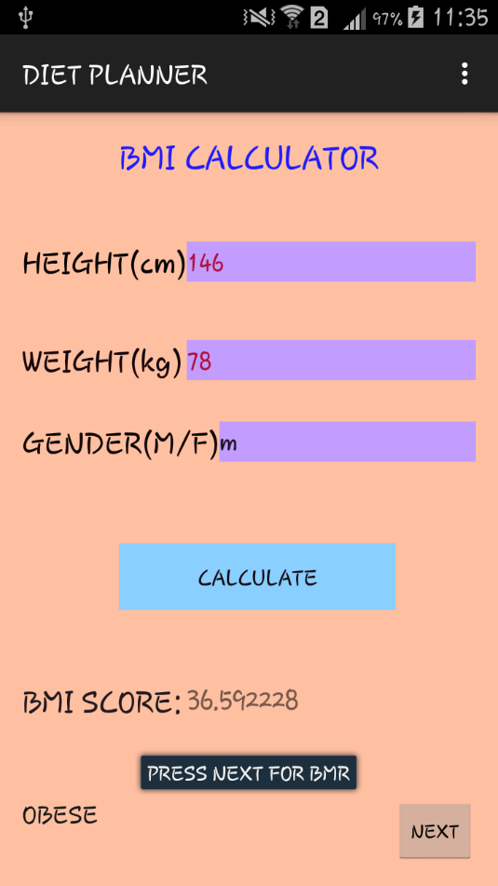
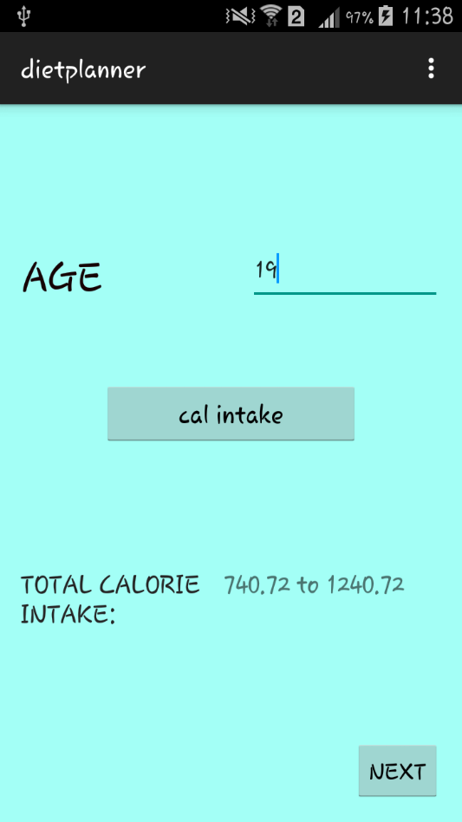
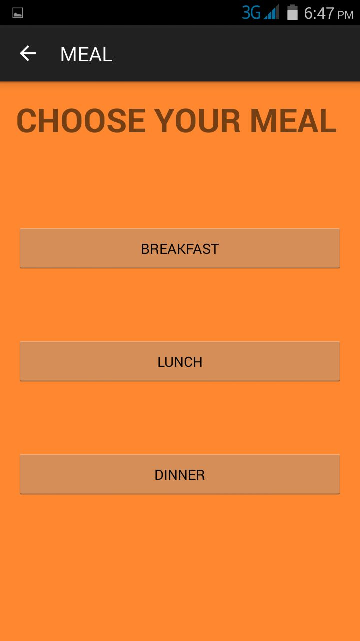
SCREEN SHOTS OF THE APP

Slide 11
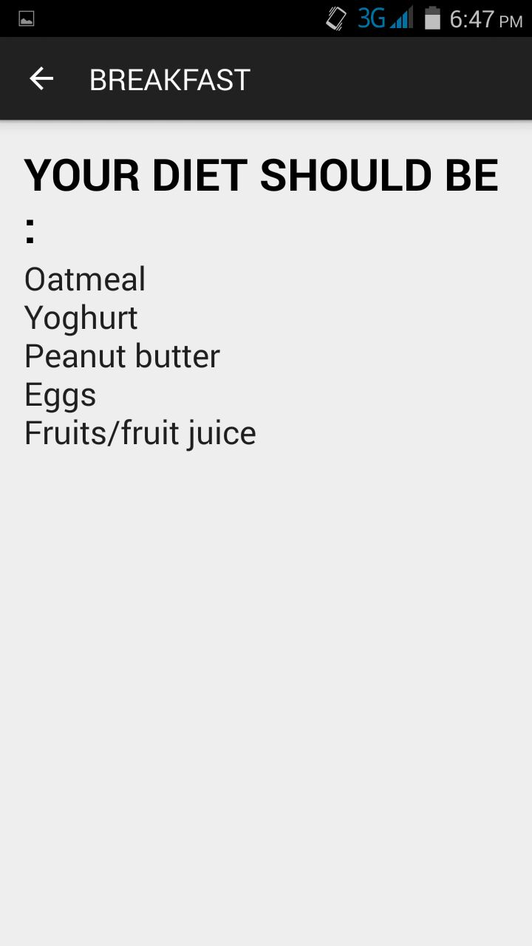
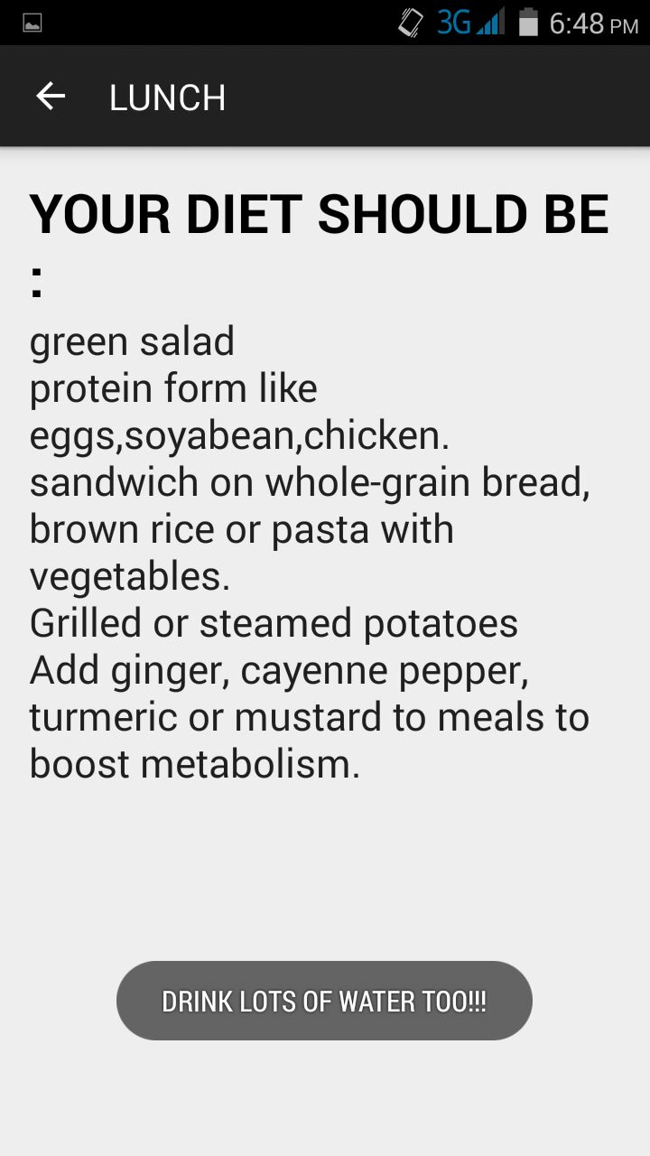
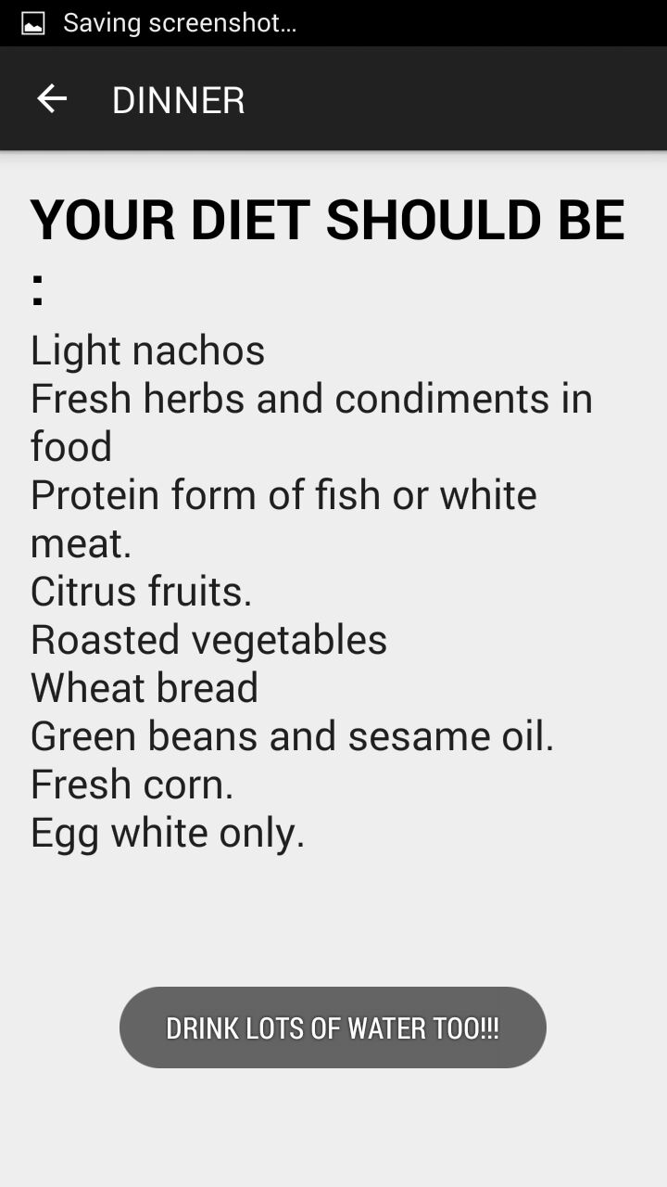
SCREEN SHOTS OF THE APP

Slide 12
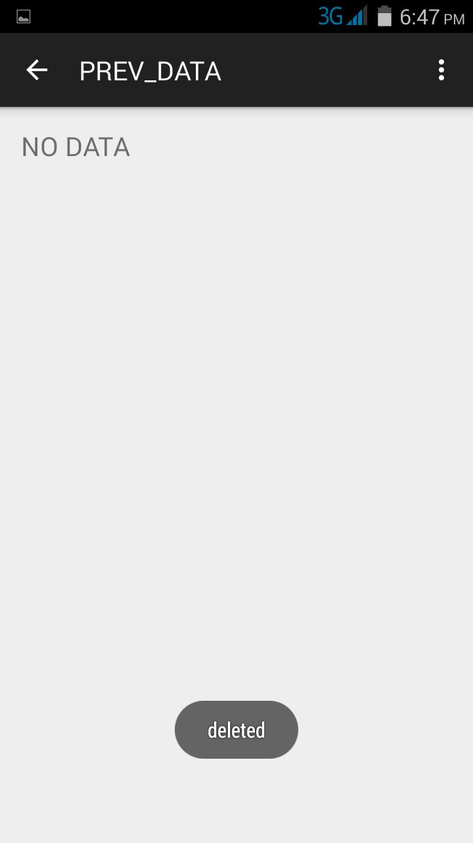
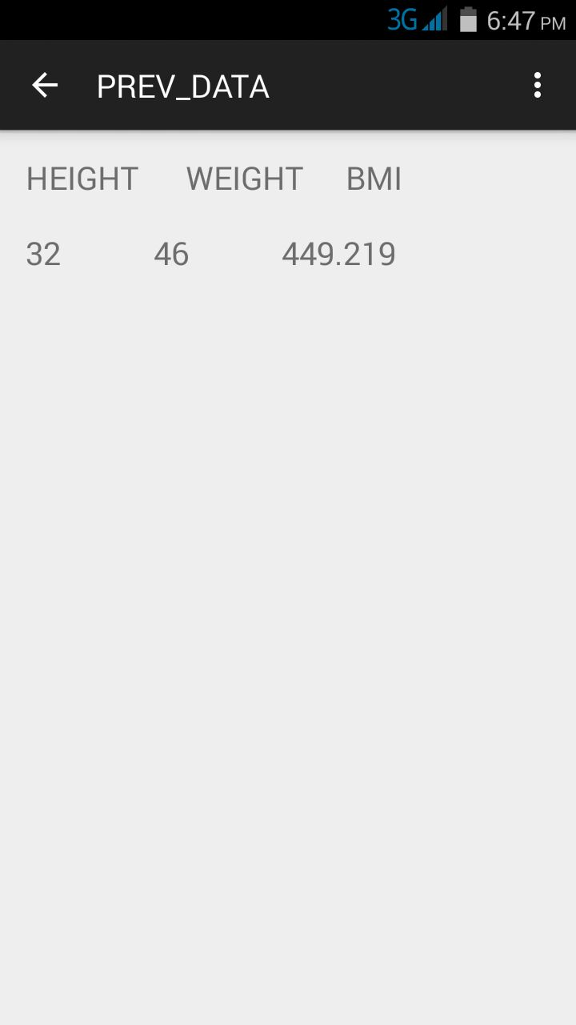
SCREEN SHOTS OF THE APP

Slide 13
THANK YOU

